Slide 1
Building the 30-year Altimetric Record
Frank Lemoine, Remko Scharroo, Severine Fournier, Stelios Mertikas, Bruce Haines and Cristina Martin Puig

Slide 2
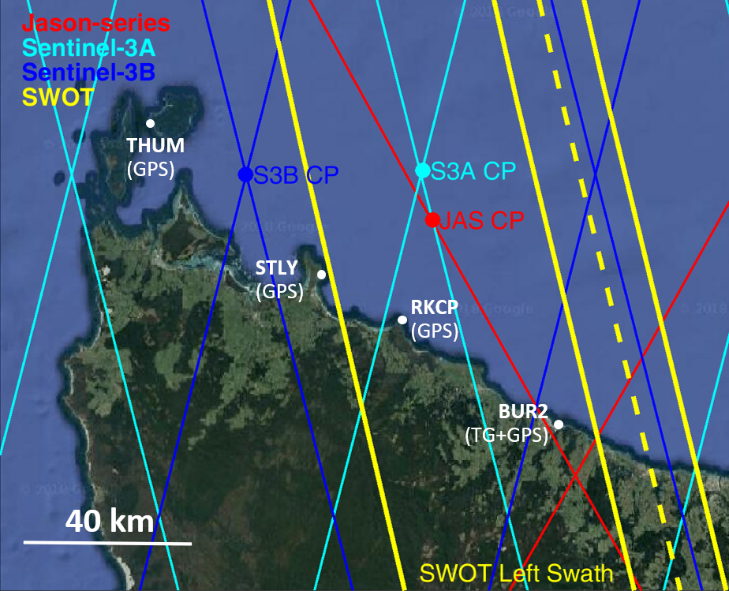
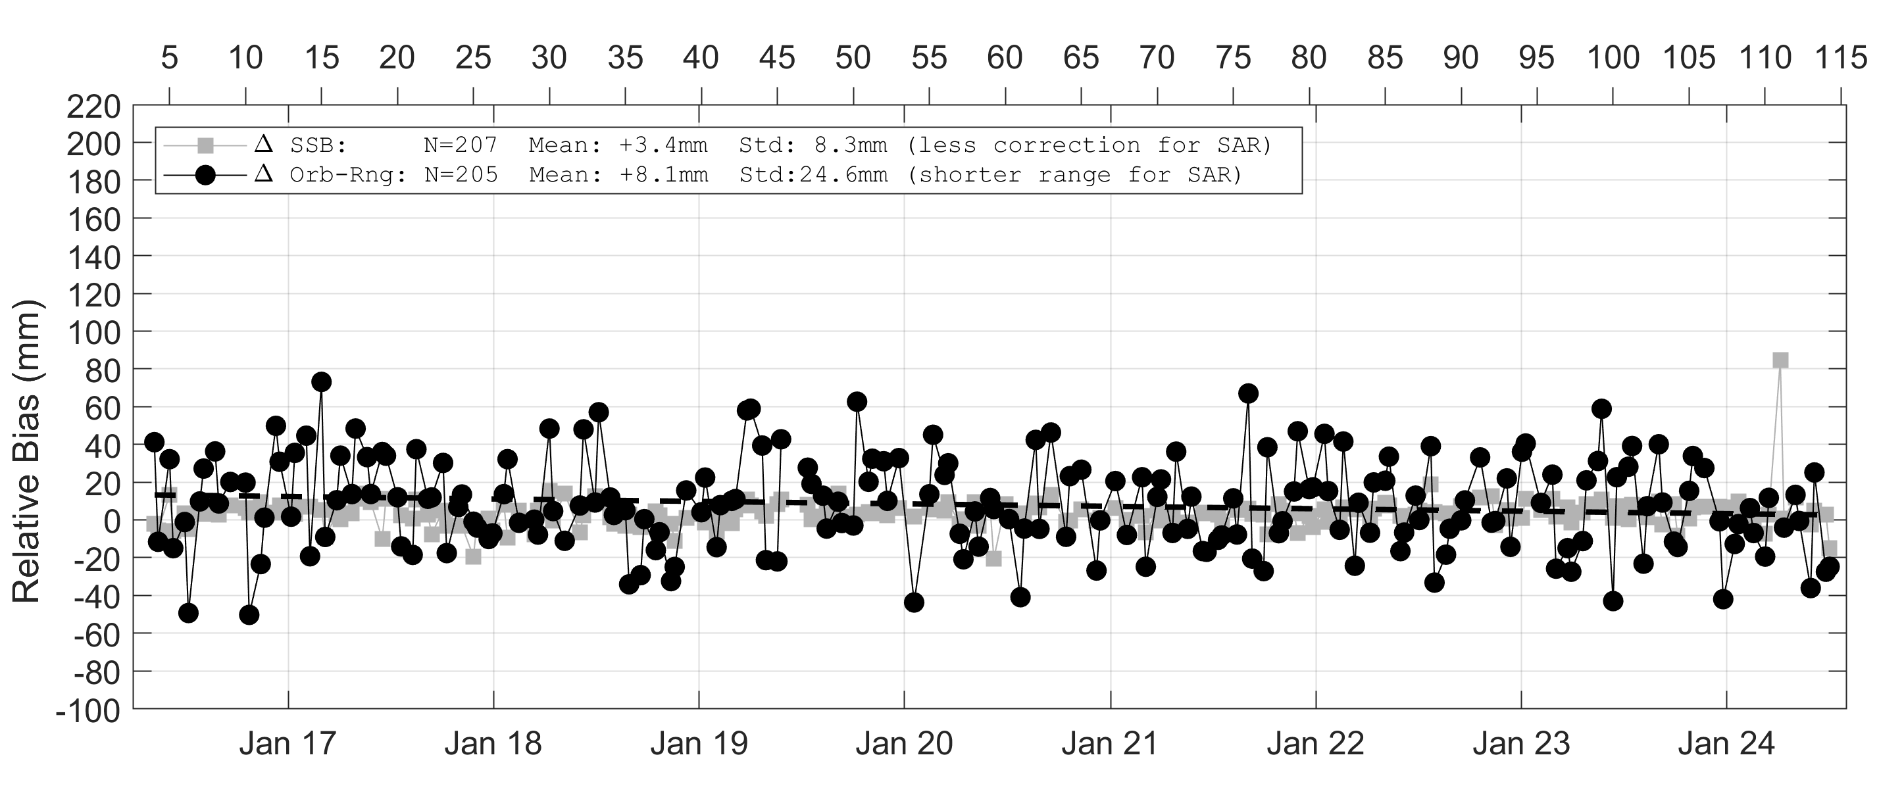
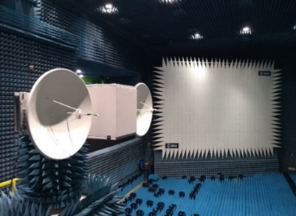
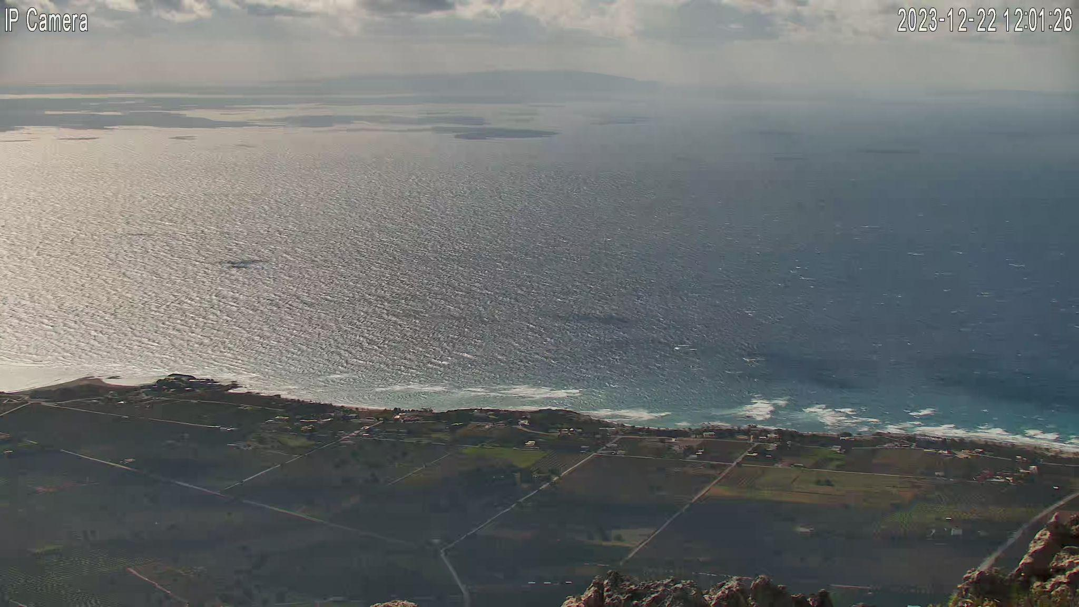
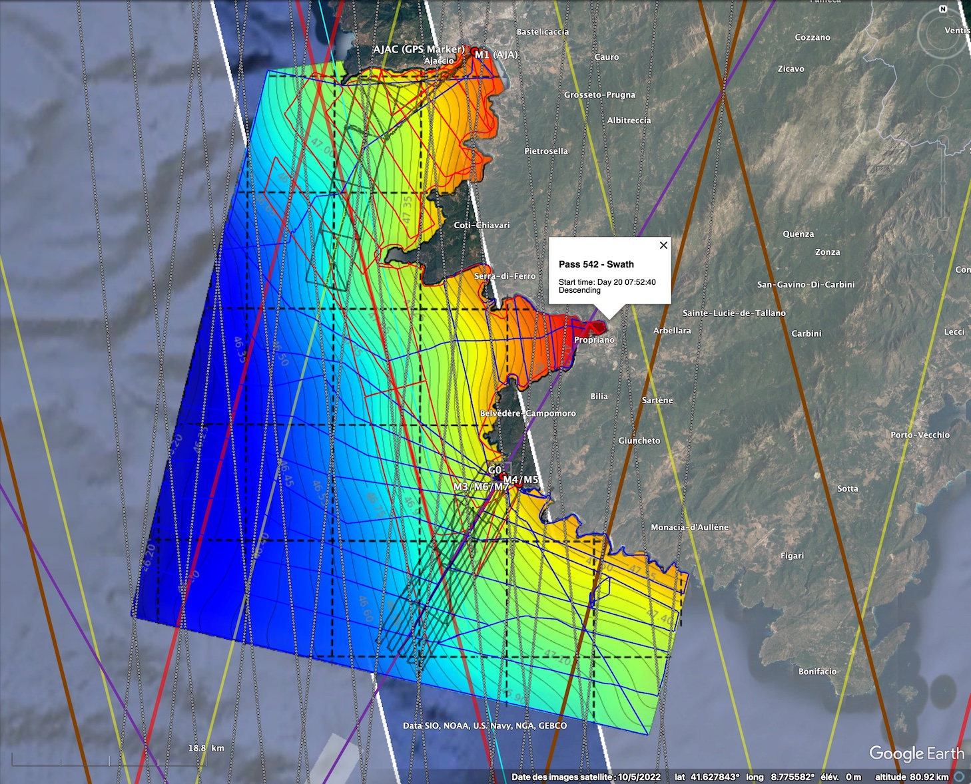
SESSION 8.1 Highlights
Dedicated In-Situ calibration techniques have been used since the beginning of altimetry era.
Processing, instrumentation and special surveys in support of increase of accuracy and also new needs
New GNSS boys.
Transponders, Corner Reflectors
Inoovative optical cameras in support of SAR altimetry for sea state characterization
bias estimation in the swath (SWOT) -> geoid measurement (“GPS carpet”). Comparison with MSS
Dedicated sites allowed to obtain long time series measurement for the mission calibration of reference and non-reference altimetry satellites

Slide 3
SESSION 8.2 Highlights
New data for old missions
FDR4ALT: ERS-1/2 and Envisat reprocessing with GPD, ERA5 and GDR-G standard added
New data for CryoSat-2:
CryoSat-2 new baseline to include new retracker.
Quality analysis and continuing upgrades of Sentinel-6 processing
Sentinel-6 product quality is very good
Differences between LR MLE4 and numerical retracking are well characterized, with NR being preferred.
HR data now including Range Walk and vertical wave motion correction
SWH now consistent across missions and between LR and HR
But we keep implementing more updates to stay state-of-the-art.
Big strides have been made in sea ice thickness observations
SAR altimetry (CryoSat-2 and Sentinel-3A/B) has been quite essential.
Difficult to validate given the sparseness and sometimes unobtainability of reference data

Slide 4
SESSION 8.3 Highlights
Updated uncertainty budget for global and regional mean sea level:
Unchanged: orbit, ITRF, GIA, and the TOPEX side A/side B drift
Updated: instrument noise, geophysical corrections, wet tropospheric correction over J3, and intermission calibration offset
New contributions proposed: uncertainty due to drift between Jason-2 and Jason-3 and sampling of the reference missions
Improvements in quantifying the trend and acceleration of the global and regional sea level, and their uncertainties:
A Bayesian method (General Least Square) shows improvements: at global scales: ~15% on the trend uncertainty, ~20% on the acceleration uncertainty; at regional scales: ~5% on trend and acceleration uncertainties
Providing trend uncertainty considering both natural variability and measurement error
Global and Regional mean sea level from reference missions only vs higher-latitude missions only:
Global scales: trends and acceleration are comparable
Regional scales: differences in trend that could be due to the wet tropospheric correction and radiometer trends.
Notes:
the drift between Jason-2 and Jason-3 is not negligible if the long-term stability target is 0.1 mm/yr over 10 years

Slide 5
SESSION 8.4 Highlights
Based on reconstruction, regional sea level trends are available for the last 70 years with a precision up to 1.92 +/. 0,2 mm/year in mean. The analysis covers seven decades (1952-2022) and relies on empirical orthogonal functions informed by deep-learning analytics. Main challenges were the removal of climate patterns with special attention to PDO which plays a significant role in regional analysis. The analysis underscores the importance of the Pacific Decadal Oscillation in explaining regional sea level variations. (C.K. Shum et al.)
A united climate record is available for the last 30 year with harmonized and consistent multi-mission models. The highlight is that new missions with more advanced technologies are now helping to improve data quality of precedent missions. SLA increase is not homogeneous (2.1 mm/year for first decade; to an acceleration up to 4.2 mm/year in the last decade) (C. Kocha, et al.).
An accelerated ocean stratification is visible through the analysis of ocean tides with more energetic ocean tides. There is early evidence of an increase of the ocean tides along the last 30 years of altimetry data records. Available tide models were extensively compared, and main improvements and drawbacks reported. (R. Ray, et al.)
Altimetry precision for an accurate estimate of Earth Energy imbalance should reach a stability of 0.1 mm/year with 95% confidence. So far this stability is not met. (M. Ablain, et al.)
The new International Altimetry Pilot Service is presented for open access to altimetry information. IAS is organized in seven clusters addressing different altimetry thematics. Presented several examples of collaborations, spanning many interdisciplinary aspects of altimetry that have grown out of this service.(X. Deng)

Slide 6
Recommendations
Need for continuity of dedicated In-Situ sites, represent significant investment supported by agencies
Calibration among missions, e.g. through extensive tandem phases (min one year for seasonal variability) is essential for a consistent and harmonized data record to support climate analysis. Together with join definition of standards to keep harmony among data products from different Agencies. The altimetry community is kindly invited to join IAS activities to support open access to altimetry information.
Increase the global coverage of reference data including in polar regions to study and remove local dependency. Need to coordinate efforts and deployments between institutes
Uncertainty budget (to achieve a 0.1mm/year stability as recommended by Meyssignac et al.):
Continuously improve the altimeter system components; improve and compare validation methods; document and improve of all components with special attention to POD estimates which constitute 30% of the error budget, and wet tropospheric correction which accounts for 20% of the overall error budget
Define new contributions for global and regional mean sea level: (1) drift between Jason-2 and Jason-3 and (2) sampling of the reference missions
Tidal coherent errors in the orbits can range from 2mm/y to 4mm/y when comparing approaches from different agencies. Geocenter orbit model differences are depicted in orbit components analysis although orbit teams ensure the models used are identical and consistent to each other. Maybe some further analysis on this deserves the attention of operational agencies.
Reevaluate and improve statistical estimation of trend and acceleration at global and regional scales
The accountability of land motion and climate patterns is a challenge and shall be further refined when doing regional analysis
A potential change of orbit for future mission should be addressed in cooperation and with enough time to make sure the in-situ capabilities can still be used (and potentially transferred) and a comprehensive analysis on the repercussions in term of science (climate change) should be done.

