Slide 1
Summary and recommendations from the OUTLOOK (FUTURE MISSIONS) session

Slide 2
Notes:
8:37
Excellent Review of Wide swath alt inception by Ernesto/Rosemary
SRTM /. WSOA – SAR wide-swath
WATER mission to ESA 2005. N Mognard/ D Alsdorf
SWOT is born
What next? T smapling mismatched with S sampling
Small scales are ageostrophic – we need an ocean current mission (NASa ODYSEA or along-track Interf.)
For hydrology also direct fluxes would be beneficial
1)Improved T coverage:
Multiple platforms (S3NGT)
Increase swath (SWOT-LOAC)
Integrate both appoaches (2035+sath/ATI constellation)
2) Measure surf curr simlutanoeusly (evolution of Seastar concept)
S3NGT mission concept %-day revisit with eff resolution 50 km
SWOT-LOAC Global Mission with coastal Emphasis
Recommendation:continuity is really imporant but innovation is also important
8:57 Alejandro Bohe
SWH at km scale with SWOT
131 people at 9:00
SWOT can be processe dto obtain NRCS images → wind speed
But also interferometric correlation (i.e. coherence) Waves cause inter Decorrelation – so the msurement can be inverted into Waves
Easy in the near range, hard in the far range
Good details on the method – static calibration with nadir SWH ofer a few passes
Validation against lidar data
Validation against buoy data
Validation aginst Sentinel-3 – very good . Noisier when swell is present
Global validation against SWOT’s nadir
Great example slides with geostr v, 2-km SWH 2k and sigma 0
Low SWH illustration
09:18 MJ Pujol
Karin L3 alt products
Prcessing scheme from L2 to L3
Nice end-to end example
Some standard susceptible to change
Residual geoid errors are a source of error in Karin data
Example of customizable data selection
~150 people at 09:30
Nice example of denoising
Product versions
..and contrbution to L4 multi-mission
09:38 Florian Le Guillou dynamical mapping of SWOT
2 mission phases – two opportunities – two challenges – nice slide
VarDyn Mapping algorithm
Good gain in effective rsolution
Applications: EKE in North Seas
Extrapolation 2D surface fields to 3D dynamics – interesting slide
Conclusion slide – can be used
Recommendation - explot the synergy of the different observables and also inter-ssions (with SST for instance)
09:58 Alejandro Egido
ESA long-term scenarion and sys architecture
Needs sourced from official EU commission documents
S3NGT mission concept
SAOOH instrument
Not that far from SWOT in terms of noise
S6 and S6NG – key science drivers fro S6NG (good slide)
Are we open to analyse new orbit configuration?
S6NG Phase 0 activities – good detail

Slide 4
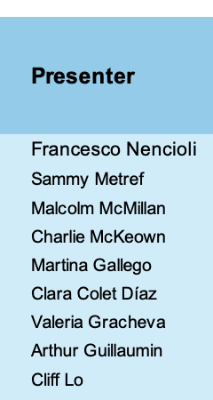

Slide 5
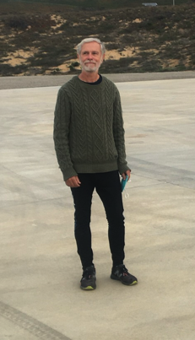
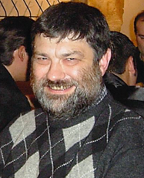
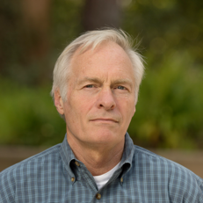
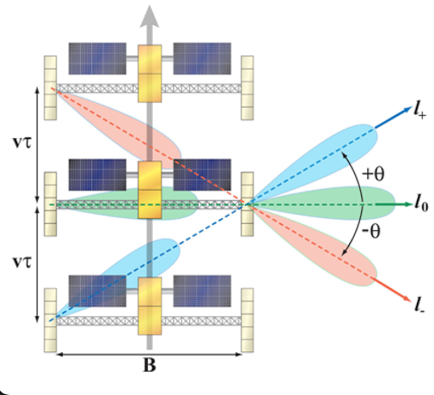
Swath altimetry (history and outlook) – E. Rodriguez/R. Morrow
A detailed account to how swath altimetry developed, from SRTM through several mission concepts by many pioneers in the field – eventually leading to SWOT and Sentinel-3 NGT
N. Mognard
D. Chelton
Y. Menard
D. Alsdorf
E. Lindstrom
L.-L. Fu
E.Rodriguez
D. Lettenmaier
L. Smith
P. Bates
T. Pavelsky
A. Cazenave
..and recently to the SWOT-LOAC concept
RECOMMENDATION (from Rosemary): continuity is really important but innovation is also important!

Slide 6
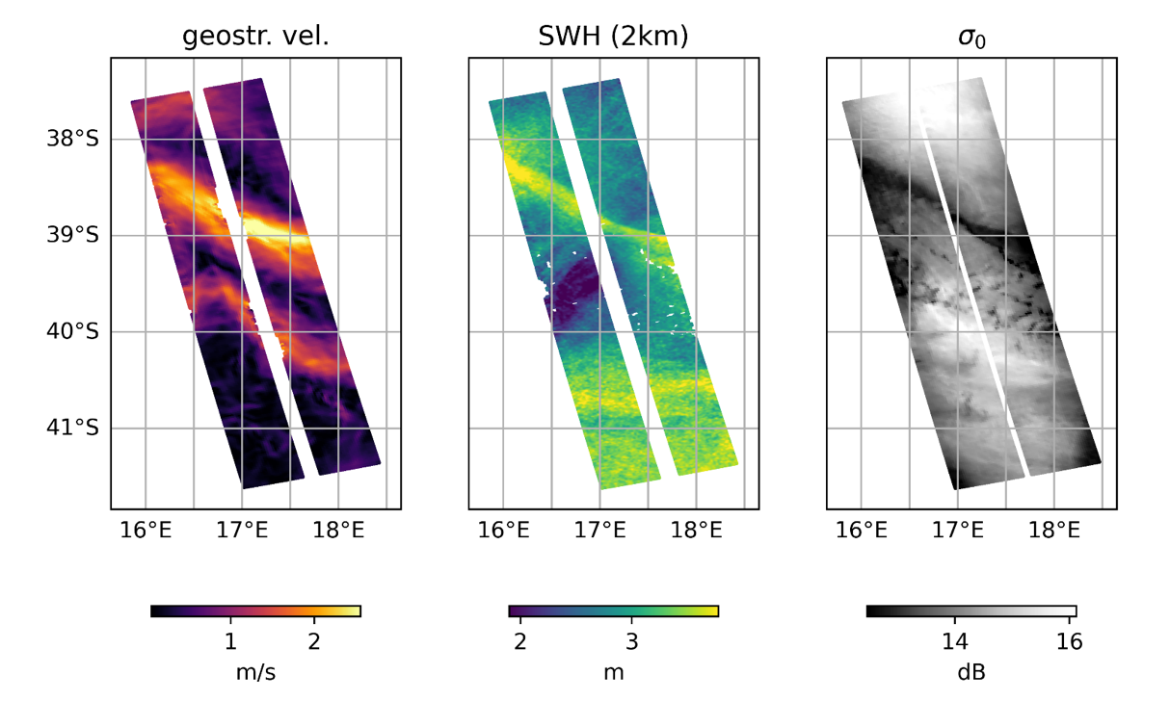
Bohe et al – SWH from SWOT at km-scale
A new window on ocean dynamics!
Globally validated against SWOT nadir
RECOMMENDATION: this needs further investigation and consolidation as it can potentially enable a lot of new science:
wave/currents interactions
effect of local winds at small scales
modulations from wave groups

Slide 7
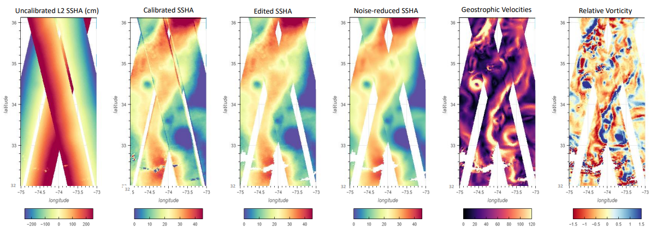
Pujol et al: SWOT L3 products
KaRIN L3
end-to-end example
L3 Wide swath altimetry can then be used in multi-mission mapping procedure → Enables finer spatial resolution in maps
RECOMMENDATION from discussion: please provide full documentation on the processing

Slide 8
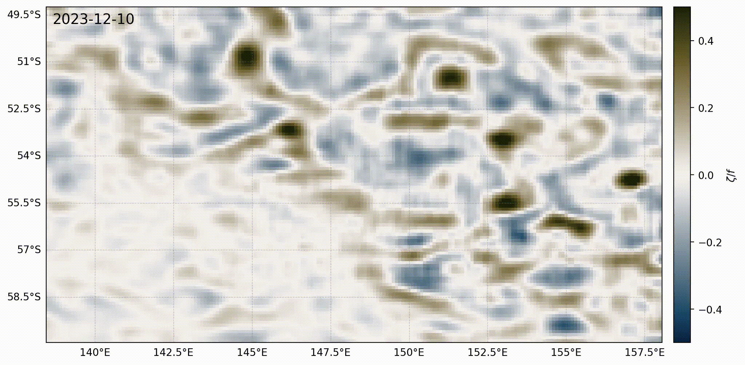
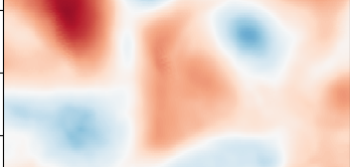
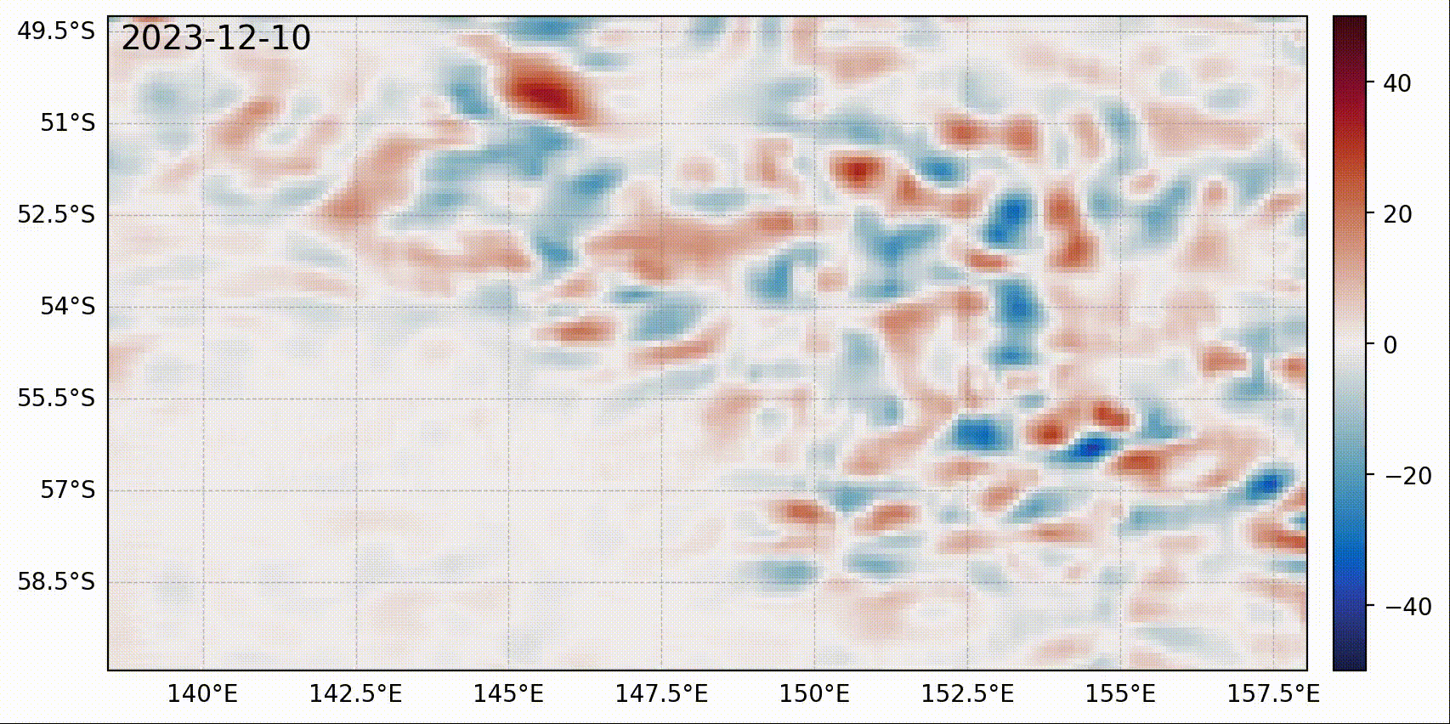
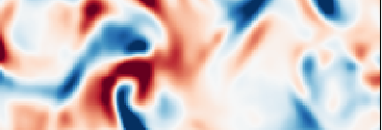
Le Guillou et al – SWOT dynamical mapping
VarDyn Mapping Algorithm – many possible applications
Reconstructed Relative velocity @ 250m depth
Extrapolation 2D surface to 3D - Effective Surface Quasi-Geostrophy (eSQG) method
(with E. Carli, LEGOS/CNES)
Surface field
VarDyn on top of MIOST
20 km
Reconstructed Vertical velocity @ 250m depth
Reconstructed field
RECOMMENDATION: explot the synergy of the different observables, also amongst different missions (with SST for instance)
exp(-Kz)
1000m
VarDyn on top of MIOST

Slide 9
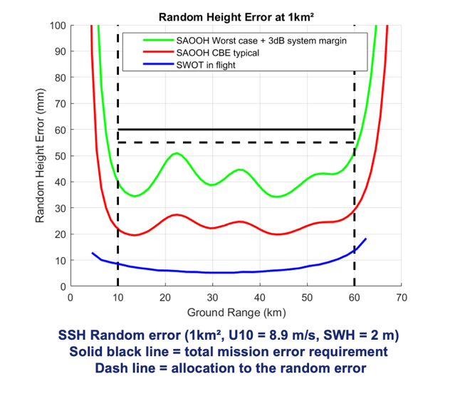
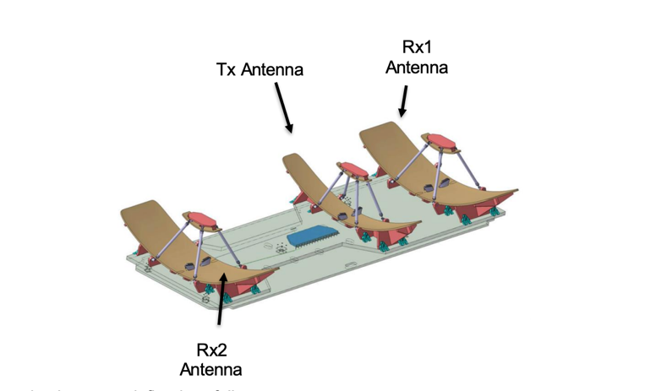
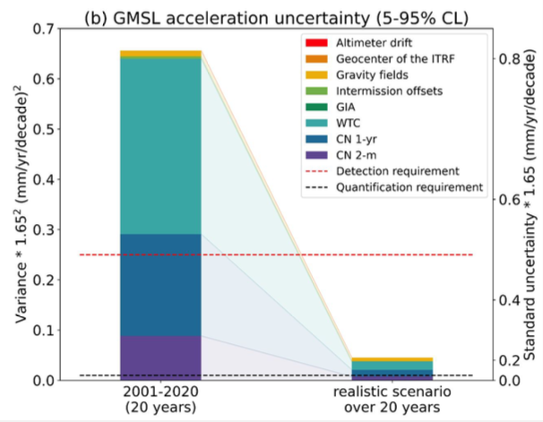
Egido – The Next Generation Copernicus Altimetry missions
The S3NG-TOPO SAOOH Instrument
Sentinel-6 Next Generation: detailed account of key science Drivers, key mission drivers and Phase-0 Activities
KEY QUESTION: Are we open to analyse new orbit configurations?
Meyssignac et al, 2023

