Slide 1
30 Years of Progress in Radar Altimetry Symposium
2-7 September 2024 | Montpellier, France
S3VT-S6VT-OSTST Technical Presentations
Alejandro Egido, Cristina Martin Puig, Pierre Féménias, Remko Scharroo,
Eric Leuliette, Bruno Lucas,
Josh Willis, Claire Maraldi

Slide 2
S3VT-S6VT-OSTST
19 Oral presentations
40 Posters
… and a lot of hot discussions
Sentinel-6
Sentinel-3
Inland waters
Polar Oceans
Retracking
Swell & Waves
Wet Tropo
Standards
Sea Level
POD
In-situ
Corner Reflector & transponders

Slide 3
Summary of Theme 13.1
Summary
Ocean retracker solutions for the reference missions were evaluated and improvements were found relative to fitting routines (MLE) and numerical retracking (A. Mangilli, et al.)
S6-MF inland water performance was evaluated during Jason-3 tandem mission, and S6 confirms benefits of SAR over LRM in terms of precision. 3 cm is attained at nadir over simple cases (N. Taburet, et al.)
S3 A&B performance over sea ice was evaluated and excellent performances observed, fully compatible with CryoSat-2 detailed in peer-reviewed publication (submitted) (S. Fleury, et al.)
Performance of S3 A&B over the high-latitude oceans was assessed and performance at large-scale and low frequency was excellent, however some questions remain for short scales, high frequency signals and open to ice covered ocean continuity (L. Rinchiuso, et al.).
Recommendation:
Optimal retracker solutions, true MLE or weighted-LS, should be used in the retracker analysis of reference missions to have unbiased, minimum variance parameters estimation and a correct estimation of parameter correlations.
Importance of long enough tandem phases (at least 10 passes) for hydro CalVal to have enough points of comparisons with in-situ as well as downstream application to compute intermission biases (N. Taburet, et al.)
Need for multi-year airborne cal/val including sea ice and snow measurements with regular measurements are needed to validate performance in polar regions (S. Fleury, et al.)
The study in colocation with S1 suggests that some leads might be missed by S3 because of the threshold on sea ice concentration → A study with a more recent dataset will clarify if it is still the case or if the issue is fixed in the most recent release (Rinchiuso L, et al.)

Slide 4
Summary of Theme 13.2
Swell Characterization from Sentinel-3 and Sentinel-6MF SAR altimetry data (L. Rodet, et al.)
In low to moderate sea state, the spectral analysis of SAR altimetry modulation gives a good proxy for swell spectrumNew missions and complementary systems (Sentinel-1, CFOSAT, swath altimeters) may improve on this.
Towards reconciliation of PLRM and SAR ocean measurements in operational context for S3 (Salvatore Dinardo, et al.)
Promising results for the correcting for SAR and PLRM inconsistencies using estimates of the mean wave period and sigmav directly from altimetry data.
Enhancing SAR Altimetry Products through Correlation-Informed Strategies (Frithjof Ehlers, et al.)
Demonstrated a noise model for the high-frequency content of SLA spectra at different posting rates. Can be used to detect problematic surface states directly from retracked variables and may be exploited to gain 5-25% precision.
Tide gauge comparisons for Sentinel-3 and Sentinel-6 (Eric Leuliette and Amanda Plagge)
30-year record of GMSL shows no significant drift (no sig. drifts for S3A/B, Jason-1/2/3 stable)
TOPEX GDR-F phase “A2” may have an offset. Needs community independent evaluation.
Recommendations
Maintaining the core GLOSS tide gauge network is critical for the sea level climate data record.
Jason-1 and Jason-2 should be reprocessed to GDR-G standards.
A Fast-Time Complex Correction for the End-to-End Range Impulse Response of the Sentinel-3 and Sentinel-6 Altimeter Systems (Pablo García, et al.)
A new instrumental correction has been proposed to compensate for phase and power distortions, improving upon the historical approach for the CAL1 instrumental correction, plus the antenna compensation.

Slide 5
Summary of Theme 13.3
Coastal evaluation of the first three years of Sentinel-6MF high-resolution wet tropospheric correction (Telmo Vieira, et al.)
HRMR improves the WTC retrieval for distances to coast up to 20 km. Reported some early mission missing data.
Refining the accuracy and stability of tropospheric corrections for satellite altimetry over coastal zones and continental surfaces (M. Joana Fernandes, et al.)
Use of dynamic WPD vertical profiles from ERA5, significantly reduces errors between WPD data at different altitudes.
Long term microwave radiometer stability assessment over different altimetry missions (Bin Zhang, Eric Leuliette)
New microwave radiometer stability monitoring system at NOAA/STAR for altimetry missions
Identified potential issues with wet tropo corrections/TBs in TOPEX GDR-F, Jason-3, Sentinel-6MF, SWOT
Performance of the radiometers on Sentinel-6 and SWOT for wet path delay correction (Shannon Brown, et al.)
Sentinel 6A AMR-C external calibration system providing unprecedented long-term stability of 0.02 + 0.07 mm/yr; Calibration will be updated for GDR-G re-processing; HRMR will be updated to eliminate drift using cold sky obs
SWOT AMR-S AMR-S meets spectral requirement, small residual inter-beam calibration bias will be corrected
Jason-3 AMR wet path delay correction for climate available; coefficients will be updated for upcoming re-processing
GDR-G Altimetry Standards (Lucas, B., et al.)
GDR-G: Newer standards (FES22B, MSS Hybrid 2023, MDT CNES/CLS 2022, POE-G) and data quality improvement
Better interoperability and facilitation for higher level products same standards as DT24 (CMEMS L3 product)
To be used on the reprocessing campaigns in 2025
Recommendation: Further continue standardization of Radar Altimeter processing for all missions

Slide 6
Summary of Theme 13.4
Highlights
Improvement of POD products (CPOD operational product and JPL new orbits based on ITRF2020)
The current level of accuracy between the CPOD QWG solutions allows to observe subtle effects such as the geocenter motion modelling, which is identified as the main topic to address in the upcoming future
The Harvest Experiment is well positioned to move forward seamlessly, without the platform itself (plate-form decommissioned) allowing to continue the Harvest long-term time series of sea level monitoring
Corner reflectors may be suitable to monitor residual range drift for GMSL stability requirement
Recommendations
Which origin to be choose for POD (Center of mass, of network)? To be specified in mission specification
Users interested in GMSL should switch to POE-G
Upcoming missions likely to rely on corner reflector networks for regular monitoring, not just for absolute range measurements but for range drift monitoring

Slide 7
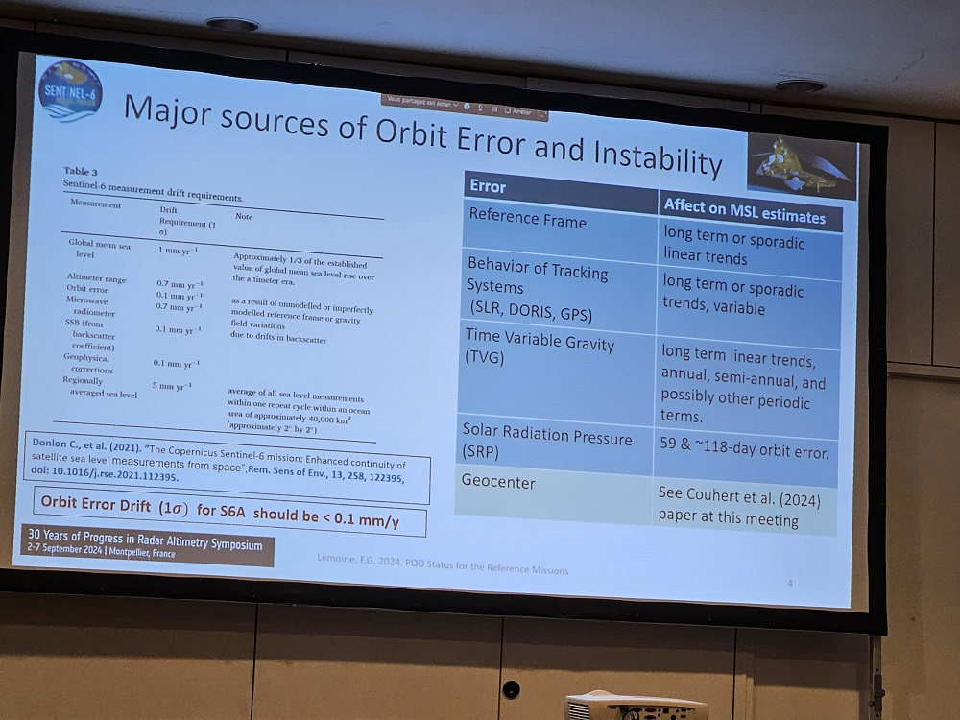
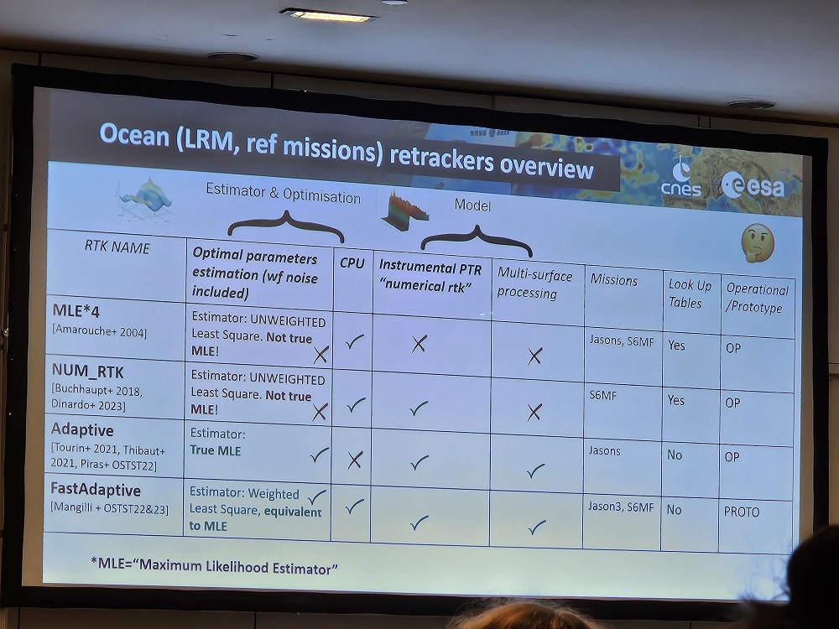
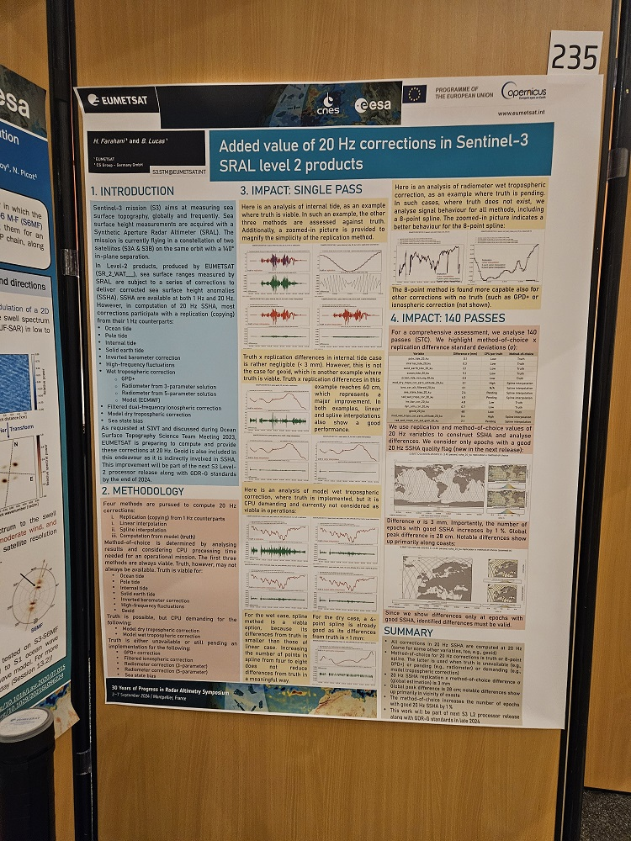
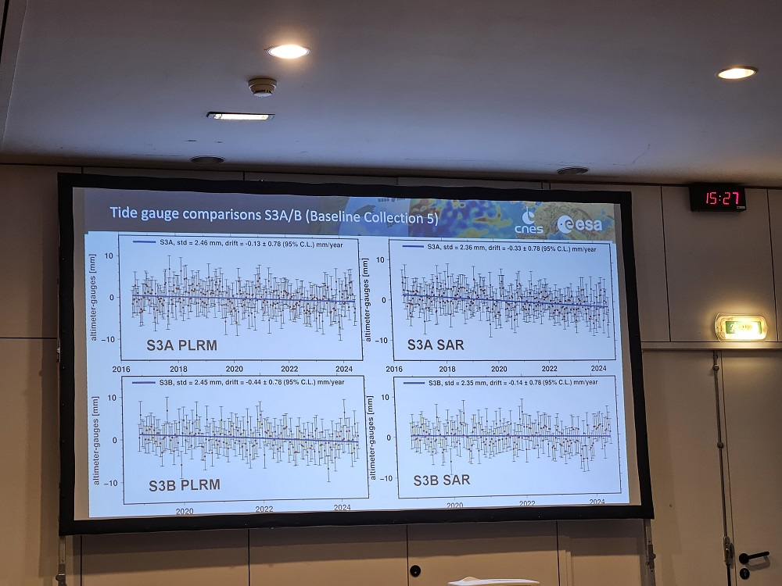
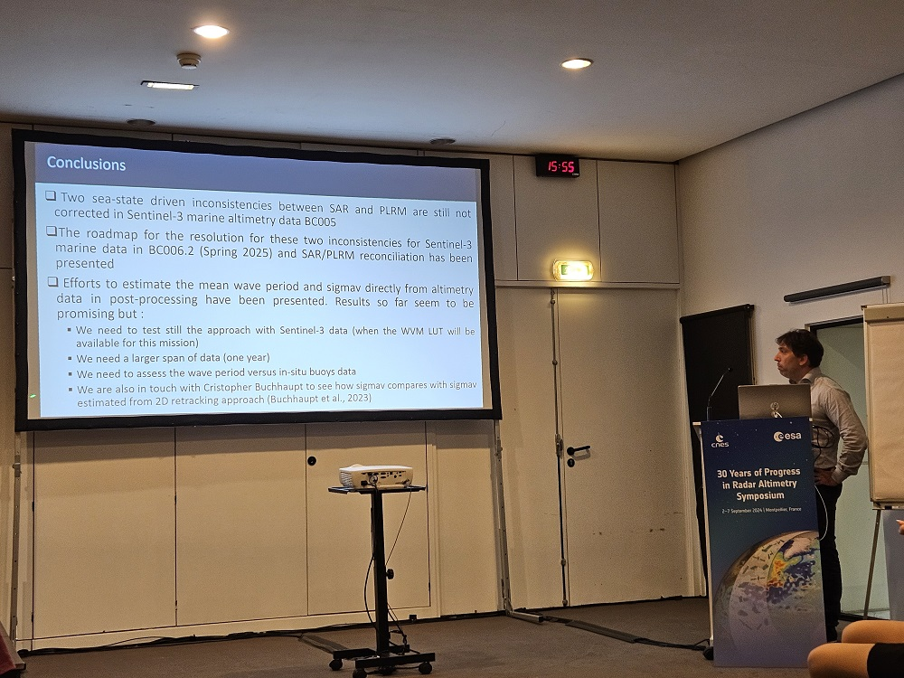
Thank you
Sentinel-6
Sentinel-3
Inland waters
Polar Oceans
Retracking
Swell & Waves
Wet Tropo
Standards
Sea Level
POD
In-situ
Corner Reflector & transponders

Slide 8
Presentation summaries

Slide 9
13.1 S3VT-S6VT-OSTST summaries and recommendations
Improvement of ocean retracker solutions for the reference missions: overview, results and perspectives (A. Mangilli, et al.
Various retrackers solutions do not account for the speckle noise in the same way, e.g. MLE4 and numerical retracker
FADS6 and BAYES6 complementary and consistent retracker solutions developed for Sentinel-6: optimal and unbiased parameters estimation, significant improvement wrt to existing solutions (MLE4,NUM_RTK)
It is important to correctly quantify the correlations among the retracked parameters (namely between SWH and epoch) to better understand derived corrections as e.g. SSB/HFA
Parameter correlations are not “retracker dependent and not due to the weighting, the correlations are correctly estimated only if the waveform noise is properly accounted in the retracker (optimal estimation)
The skill of ocean dynamic persistence raises the bar for evaluating ENSO prediction skill (by informing coupled models the extent to which coupled model dynamics add to prediction skill beyond initial ocean state).
Recommendation:
Optimal retracker solutions (Adaptive, FastAdaptiveS6, BayeS6) must be used in the retracker analysis of reference missions to have unbiased, minimum variance parameters estimation and a correct estimation of parameter correlations (e.g. Bayesian analysis with robust estimation of paremeters (co)variance.

Slide 10
13.1 S3VT-S6VT-OSTST summaries and recommendations
Sentinel-6 Michael Freilich performances assessment over Inland Waters during tandem phase with Jason-3 (N. Taburet, et al.)
Tandem phase allowed the qualification of the SAR / LRM bias which is sigma0 dependant (OCOG retracker). Of interest to reconstruct unbiased timeseries over the Jason-S6 period => Accounted for in Copernicus Services
S6 confirms benefits of SAR over LRM in terms of precision. 3 cm is attained at nadir over simple cases
SAR allows defining a new type of virtual stations: Off-Nadir VS
=> very useful for absolute bias quantification wrt insitu comparisons to avoid slope and lag time difficulties
=> Sinc² retracker almost unbiased (compared to OCOG with about 20cm bias)
Complex cases (meanders, locks/steps) are better handled with Hamming filtering and even further with FFSAR : better than 10 cm precision can be achieved
Recommendations
Importance of long enough tandem phases (at least 10 passes) for hydro CalVal to have enough points of comparisons with in-situ as well as downstream application to compute intermission biases
Continue R&D to exploit off nadir signal
Develop multi peak retracking algorithms to handle contamination by other water body echoes

Slide 11
13.1 S3VT-S6VT-OSTST summaries and recommendations
SENTINEL-3 STM MPC : Performances of the S3A and S3B surface topography mission over sea-ice (Sara Fleury, et al.)
The Full Mission Reprocessing of Sentinel-3A and 3B was performed in 2023
Excellent performances observed, fully compatible with CryoSat-2 detailed in peer-reviewed publication (submitted)
Updated Sea-Ice concentration (OSI430a) and Sea-Ice Type (OSI403d) parameters now available
Generation of time series of freeboard volume showing consistent variations → promising for the future sea-ice thickness computation
S3A and S3B will allow a drastic increase the density of sea-ice measurements close to the Arctic and Antarctic coasts relatively to CS2 alone (about x7 more data!).
First evaluations against in-situ reference measurements (OIB airborne and BGEP moorings) with very good results.
Inclusion of Sea-Ice Thickness (SIT) variable in the 2025 Processing Baseline.

Slide 12
13.1 S3VT-S6VT-OSTST summaries and recommendations
Performance assessment of Sentinel-3 high latitude observations for the future polar ocean products (Rinchiuso L, et al.)
Overall quite good performance of Sentinel-3 over polar oceans
At large scale/low freq S3A & S3B show good performance on ice-covered oceans
Very good spatial and temporal internal consistency between S3A and S3B, slightly degraded on leads in the Southern Ocean
Geographical differences of leads ratio wrt SARAL/AltiKa and CryoTEMPO (i.e. possible waveform classification inaccuracies)
High frequency SSHA differences wrt SARAL/AltiKa and CryoTEMPO (i.e. instrumental processing errors for peaky echoes from leads)
Residual ice-covered/open ocean bias of about 4-5 cm
No dedicated retracker for polar regions + degradation in coastal areas
We're ready to quantify the improvement brought by the next evolutions of EUMETSAT products
Recommendations
The study in colocation with S1 suggests that some leads might be missed by S3 because
of the threshold on sea ice concentration → A study with a more recent dataset will clarify if it is
still the case or if the issue is fixed in the most recent release

Slide 13
S3VT-S6VT-OSTST summaries and recommendations
Swell Characterization from Sentinel-3 and Sentinel-6MF SAR altimetry data (L. Rodet, T. Moreau, O. Altiparmaki, F. Ehlers, C. Maraldi, F. Boy, N. Picot)
In low to moderate sea state, the spectral analysis of SAR altimetry modulation gives a good proxy for the swell spectrum, allowing us to estimate its wavelength and direction (within ambiguities). “Noise” becomes information!
The resolution along-track is limited by random vertical wave motion (characterized by the vertical velocity variance 𝜎_𝑣), and across-track by the steepness of the waves (characterized by the SWH).
Without an efficient MTF, the proportion of suitable cases is small. We can identify suitable cases using external data (model, colocations, buoys).
New missions and algorithms may improve our swell characterization capacities in the near future, in complementarity with the existing constellation systems (Sentinel-1, CFOSAT, swath altimeters), to be used in wave models.

Slide 14
S3VT-S6VT-OSTST summaries and recommendations
Towards a reconciliation of the PLRM and SAR altimetry ocean measurements in an operational context for Sentinel-3 (Dinardo Salvatore, Scharroo Remko, Lucas Bruno)
Two sea-state driven inconsistencies between SAR and PLRM are still not corrected in Sentinel-3 marine altimetry data BC005
The roadmap for the resolution for these two inconsistencies for Sentinel-3 marine data in BC006.2 (Spring 2025) and SAR/PLRM reconciliation has been presented
Efforts to estimate the mean wave period and sigmav directly from altimetry data in post-processing have been presented. Results so far seem to be promising but :
We need to test still the approach with Sentinel-3 data (when the WVM LUT will be available for this mission)
We need a larger span of data (one year)
We need to assess the wave period versus in-situ buoys data
We are also in touch with Cristopher Buchhaupt to see how sigmav compares with sigmav estimated from 2D retracking approach (Buchhaupt et al., 2023)

Slide 15
S3VT-S6VT-OSTST summaries and recommendations
Enhancing SAR Altimetry Products through Correlation-Informed Strategies (Frithjof Ehlers, Thomas Moreau, Laetitia Rodet, Marta Alves, Claire Maraldi, Cornelis Slobbe, Marcel Kleinherenbrink)
In the meantime, we demonstrated that the developed noise model reproduces the high-frequency content of SLA spectra at different posting rates, can be used to detect problematic surface states directly from the retracked variables, and may be exploited to gain an additional 5-25% of precision.
Validation on one Sentinel-6 cycle pending.
Tide gauge comparisons for Sentinel-3 and Sentinel-6 (Eric Leuliette and Amanda Plagge)
30-year record of GMSL shows no significant drift
TOPEX GDR-F: phase “A2” may have an offset.
Jason-3: No significant drive with the JPL AMR path delay correction applied.
Sentinel-6MF: Potential offset/drift in LR MLE4 during 2024, but the available number of high-quality gauges has declined
Sentinel-6MF: Waiting for full mission reprocessing of corrected LR NR ,HR/SAR, and HR NR
Sentinel-3: No significant drifts and low variance
Recommendations
Maintaining the core GLOSS tide gauge network is critical for the sea level climate data record.
Drifts/offsets in TOPEX GDR-F need continued independent evaluation.
Jason-1 and Jason-2 should be reprocessed to GDR-G standards.
Add ERA5-DAC and ERA5 troposphere corrections (J1/J2) to RADS.
Sentinel-3 should be considered as a supplementary source of global mean sea level monitoring.

Slide 16
S3VT-S6VT-OSTST summaries and recommendations
A Fast-Time Complex Correction for the End-to-End Range Impulse Response of the Sentinel-3 and Sentinel-6 Altimeter Systems (Pablo García, Salvatore Dinardo , Albert Garcia-Mondéjar, Adrià Gómez, Adrián Flores, Mònica Roca i Aparici, Robert Cullen, Marco Fornari)
Observations of the phase and power figures in specular natural targets echoes triggered studies on necessary corrections to compensate the distortions.
A new instrumental correction has been proposed, improving the historical approach for the CAL1 instrumental correction, plus the antenna compensation.
A validation effort has been done by S. Dinardo (EUMETSAT) and by isardSAT to test the performances of the new approach.
Positive results have been observed using different targets, missions and processing approaches.
Coastal evaluation of the first three years of Sentinel-6MF high-resolution wet tropospheric correction (Telmo Vieira, M. Joana Fernandes, Pedro Aguiar, Clara Lázaro)
HRMR improves the WTC retrieval for distances to coast up to 20 km
[05-20 km] mainly for distances to coast in this range
[00-05 km] in 84% of the WTCRad retrievals with distances to coast in this range, WTCRad is not available (WTCRad = WTCAMR).

Slide 17
S3VT-S6VT-OSTST summaries and recommendations
Refining the accuracy and stability of tropospheric corrections for satellite altimetry over coastal zones and continental surfaces (M. Joana Fernandes, Telmo Vieira, Pedro Aguiar, Clara Lázaro)
The use of dynamic WPD vertical profiles from ERA5, significantly reduces the errors in the comparison between WPD data at different altitudes.
The method is tuned for the reduction from upper to lower WPD levels, as required in coastal altimetry and in GPD+ WTC computations.
The computation of DTC from SP instead of SLP, reduces the error in the DTC estimation at high altitudes by 1-2 cm, ensuring an accuracy in the DTC estimation better than 1 cm.
ERA5 is the atmospheric model with the best compromise between precision and stability and should be adopted for climate studies, whenever WPD based on observations are not available, such as coastal and inland water regions.

Slide 18
S3VT-S6VT-OSTST summaries and recommendations
Long term microwave radiometer stability assessment over different altimetry missions (Bin Zhang, Eric Leuliette)
A microwave radiometer stability monitoring system has been built at NOAA/STAR for altimetry missions based on RADS, NOAA JPSS satellites datasets and other datasets.
Reprocessed TPX WTC has a drop of ~3mm from 1992-2000 and slightly increase after.
Jason-1/Jason-2 WTC time series has large variations (referenced to ERA-interim), which may need to be reprocessed. However, a comparison with ERA-5 when the data is available in RADS will be updated. We recommend RADS to be updated to include ERA-5 for all mission
Jason-3 WTC still shows a small drop around 2020.
Sentinel-6 WTC time series is very stable referencing to ERA-5/ECMWF and shows stable radiometer performance, especially 23.8GHz. BT time series in 34.0 GHz shows a positive trend, over time, which might be significant.
SWOT WTC (Nadir) has an increase around ~3mm since launch. The BT time series in 23.8GHz shows a larger departure from S6A in mid 2024 than other two channels.

Slide 19
S3VT-S6VT-OSTST summaries and recommendations
Performance of the radiometers on Sentinel-6 and SWOT for wet path delay correction (Shannon Brown, Chun Sik Chae, Shailen Desai)
Sentinel 6A
AMR-C on Sentinel 6A is most advanced microwave flown to date on an altimeter mission
External calibration system providing unprecedented long-term stability of 0.02 + 0.07 mm/yr
Calibration will be updated in October 2024 for 2025 GDR-G re-processing
Minor changes to low-frequency coefficients to smooth short term noise
HRMR coefficients will be updated to eliminate drift using cold sky obs
SWOT
AMR-S provides first swath path delay product for an altimeter mission
Small residual inter-beam calibration bias (~2mm/70km) will be corrected in updated coefficients (delivery in September 2024)
Comparison to GMI shows AMR-S meets spectral requirement
Investigation of new interpolation methods planned
Jason-3
Jason-3 AMR wet path delay correction for climate available on PO.DAAC, coefficients will be updated in October 2024 for upcoming re-processing

Slide 20
S3VT-S6VT-OSTST summaries and recommendations
GDR-G Altimetry Standards (Lucas, B., Martin Puig, C., Bignalet-Cazalet, F., Cullen, R., Maraldi, C., Leuliette, E., Desjonqueres, J. , Di Bella, A)
GDR-G update: Data quality improvement
Newer standards
FES22B
MSS Hybrid 2023
MDT CNES/CLS 2022
POE-G (dynamic, not in sync with the processors)
Better interoperability
Same standards as DT24 (CMEMS L3 product)
Preparation/facilitation for higher level products
To be used on the reprocessing campaigns in 2025
Recommendation: Further continue standardization of Radar Altimeter processing for all missions

Slide 21
S3VT-S6VT-OSTST summaries and recommendations
The Harvest Experiment After Thirty Years: Challenges and New Perspectives (Bruce Haines, Shailen Desai, Jean Damien Desjonquères, Andy Wu and Scott Stalin)
Good consistency between Sentinel-6 Sides A&B: indistinquishable differences at Harvest
Absolute (geocentric) SSH slightly high at Harvest: Side A/B MLE-4: +28/30 ± 15 mm
Relative SSH slightly high at Harvest: Side A/B - Jason-3: +6/+12 ± 4 mm
Sentinel-6 AMR-C path delay remains wetter than GPS, by ~1 cm at Harvest.
Harvest comparisons favor dry conditions (mean wet delay < 10 cm).
Results continue to hint at a scale error (differences are smaller for wet overflights).
SWOT SSH bias also slightly high (38 mm).
The Harvest Experiment is well positioned to move forward seamlessly, without the platform itself.
Calibration metrics from GPS buoys are competitive with those from platform, except under high wave conditions.
New results from Vandenberg tide gauge show good consistency with Harvest.
Stable land at Vandenberg is an advantage compared to the platform.
Coupled with assets on Catalina (e.g., Transponder), Harvest will continue to provide insights on current and future altimetric systems.

Slide 22
S3VT-S6VT-OSTST summaries and recommendations
Copernicus POD Service: Status of the Copernicus Sentinel Satellite Orbit Determination
(Fernandez C, Muñoz M, Fernandez J, Peter H, Féménias P, Nogueira-Loddo C)
We have tested and implemented updates to our current processing for POD (std2006_cs21).
The new orbits based on the ITRF2020, the grgs_rl05 gravity model, (and including SLR+COSTG for S6a) and the Conrad et al. (2023) micromodel for Sentinel-6A – show consistent improvements, (e.g. wr.t. altimeter crossovers).
We have computed the impact on the radial orbits and the GMSL of these improvements, and they are < 0.1 mm/yr on the global rate.
Some further improvements need to be implemented: e.g. new GOT5.X from R. Ray.

Slide 23
S3VT-S6VT-OSTST summaries and recommendations
GDR-G Altimetry Standards (F.G. Lemoine, N.P. Zelensky, B.D. Beckley, X. Yang,
T. Thomas, S.B. Luthcke, T. Pennington, D.S. Chinn)
We have tested and implemented updates to our current processing for POD (std2006_cs21).
The new orbits based on the ITRF2020, the grgs_rl05 gravity model, (and including SLR+COSTG for S6a) and the Conrad et al. (2023) micromodel for Sentinel-6A – show consistent improvements, (e.g. wr.t. altimeter crossovers).
We have computed the impact on the radial orbits and the GMSL of these improvements, and they are < 0.1 mm/yr on the global rate.
Some further improvements need to be implemented: e.g. new GOT5.X from R. Ray.
Recommendations
We need to complete the comparisons of the new generation of orbits (POE-G, JPL reduced-dynamic, GSFC etc) all based on ITRF2020 and improved background models.
We need to isolate the differences in our respective orbits for the different satellites that are caused by geocenter or nonconservative force modelling.
The sea level processing teams need to adopt consistently the new standards, and no longer rely on the ITRF2014-based and stale-gravity-model-based orbits, which are now out-of-date.
We need a routine production and delivery of a static and time-variable gravity derived from GRACE, GRACE-FO and SLR processing. This is important to avoid geographically correlated differences in orbits that can amount to a few tenths of mm/yr.
Continued effort to improve non-conservative force modelling on S6A is required.

Slide 24
S3VT-S6VT-OSTST summaries and recommendations
St3TART-FO: Fiducial Reference Measurements for Sentinel-3 Hydro-Cryo Altimetry products and beyond
(C. Miller, J-C. Poisson, N. Picot, H. Skourup, S. Fleury, V. Favier, G. Picard, G. Moholdt, E. Woolliams, S. Behnia, E. Le Merle, V. Boulenger, R. Ferrari, D. Segura, J. Sabalbal, M. Dechamp-Guillaume, V. Fouqueau, R. Lopez, C. Yanez, J. Lefebve, R. F. Hansen, S. Simonsen, S.Hvidegaard, L. Arnaud, E. Lemeur, C. Haas, T. Krumpen, N. Taburet, J. Renou, M. Chapellier, J. Aublanc, A. Tarpanelli , N. Sneeuw, M. Tourian, J. Foster, F. Vivier, A. Lourenco, R. Ricker, O.Rydeng Jenssen, H. Yésou , M. Azzoni, S. Amzil, T. Le Dauphin, P. Bonnefond, O. Laurain, M. El Hajj, F. Catapano, P. Féménias)
Context & Objectives:
St3TART-FO’s core objective is to operationally provide Fiducial Reference Measurements (FRM) to support the validation activities of the Sentinel-3 SAR altimeter Hydro-Cryo Thematic data products, over inland waters, sea ice, and land ice areas.
Important activity for the Copernicus Sentinel-3 mission, a joint operation between ESA and EUMETSAT for which ESA oversees the S3 Hydrology and Cryosphere Ground Segment operations.
The project’s aim to ensure the successful operational provision of FRM ultimately contributes to the broader goals of S3 mission in providing accurate and reliable Earth observation data.
Will pave the way for other future altimetry missions such as CryoSat-2, ICESat-2, CRISTAL, and S3 Next-Generation Topography as well as for potential synergies with the Copernicus CIMR expansion mission.

Slide 25
S3VT-S6VT-OSTST summaries and recommendations
Corner Reflectors For Radar Altimeter External Calibration: Lessons Learnt From The First Three Years Of Measurements At The Montsec Calibration Facility (Ferran Gibert, Adrià Gómez- Olivé, Albert Garcia-Mondéjar, Adrián Flores de la Cruz, Sergi Hernández, Ester Vendrell, Mònica Roca i Aparici)
Corner reflectors have demonstrated excellent performance as external calibration point targets for radar altimeters
FFSAR mandatory, due to low SCR achieved by alternative processors.
Performance comparable to transponders, at reduced cost and minimal maintenance.
Upcoming missions likely to rely on corner reflector networks for regular monitoring, not just for absolute range measurements but for range drift monitoring.
Portable corner reflectors useful research studies and new site feasibility tests.

