Slide 1
Closing Remarks
Jérôme Benveniste and Pascal Bonnefond
Chairs of the Organising Committee

Slide 2
448 participants from 33 countries

Slide 3
482 Abstract submission for 13 themes
1) 30 Years of Progress (keynotes)
2) Ocean
3) Coastal
4) Polar ocean
5) Geoid, bathymetry and orbit
6) Land and Inland Water
7) Cryosphere
8) Building the 30-year record
9) Synergy and "The integrated approach"
10) Outreach
11) Next generation altimetry
12) The International DORIS Service (IDS)
13) S3 - S6 VT and OSTST Technical Presentations
Notes:
1) 30 Years of Progress in Radar Altimetry: a historical perspective (keynote presentations)
Historical review
Lessons learned in the last five years
Improvements thanks to SAR, Ka and Swath altimetry
Successful and unachievable projects, unexpected applications in:
Global Ocean,
Coastal Zone,
Polar Ocean
Land and Inland Water,
Cryosphere
2) Advances in our understanding of the dynamic ocean
Ocean currents: how have things improved in 30 years?
Large scale ocean phenomena: intra-seasonal, seasonal cycle, El Nino, Rossby waves, pluri-annual oscillations
Tide modeling, non-linear components, internal waves
High frequency signals and mesoscale
Marine meteorology, wave height and wind speed
Detecting rain, air-sea exchange fluxes
3) Advances in our understanding of coastal processes
Coastal retracking
Coastal corrections
Integration of multi-mission coastal products
Modeling coastal processes
Data assimilation in coastal/regional models
Societal impacts (e.g., erosion, storm surges...)
4) Advances in our understanding of the polar ocean
Ocean dynamics and Sea-ice monitoring, sea-ice thickness, sea-ice extent
Iceberg tracking
Impact of polar ocean to Mean Sea Level
Retracking, specific corrections and processing methods in those complex zones (tides, MSS, ...)
Integration of multi-mission products
Modeling processes
Data assimilation
5) Altimetric contributions to gravity field, marine geoid, bathymetry modeling and orbit determination
The impact of long repeat mission, further improvements, and expectations
Ocean floor topography mapping
Orbit determination and gravity model tailoring: contributions of DORIS
DORIS, GPS, laser techniques and altimetry
Gravimetry results from geodetic missions (including CHAMP, GRACE, GOCE, SWARM and preparation for MAGIC/NGGM)
Improved mean sea surfaces (contributions from geodetic missions)
6) Altimetry over Land and Inland Water
Specialised data processing for inland water applications
River level and river discharge and land-ocean exchange (with focus on estuaries)
Lake level and volume variation monitoring
Wetlands
Synergy of altimetry with other remote sensing data
Hydraulic and hydrologic modelling and data assimilation
Global digital elevation models (and continuity with tidal flats and coastal bathymetry)
Land processes, surface roughness and soil moisture
7) Advances in our understanding of the Cryosphere
Antarctic and Greenland topography, volume and mass balance
Continental glaciers
(The polar ocean is in theme 4)
8) Building the 30-year altimetric record: challenges and achievements
(Cross-)Calibration and long-term monitoring of instruments: biases, drift models, shortcomings, improvements
Validation of long time-series with in situ data
From LRM to SAR altimetry: how to insure a seamless transition
Global and regional multi-satellite sea level change: the spatial and temporal record
Advances in precision: from 15 cm to the millimeter (and sub mm/yr) challenge!
Interesting/unexpected scientific results: absolute dynamic topography, global and regional mean sea level trends, lake and river discharge trends, ice volume trends, interannual changes in eddy processes, decadal oscillations...
9) Synergy between Altimetry, other data and models: "The integrated approach"
Comparison with in situ data: tide gauges, ship data, buoys, Argo profilers and HF radar ...
Synergy with variable gravity (GRACE, GRACE-FO, MAGIC/NGGM), thermosteric (Argo) and Altimetry.
Synergy of sea level, sea surface temperature, ocean colour, sea surface salinity and wind stress
Synergistic studies of the interaction of ocean circulation with ocean biology and air-sea coupling processes
Altimetry impact in ocean monitoring and operational forecasting systems
Operational hydrology
10) Outreach
Education programmes
Science returns towards the public
The use of the internet and social media to promote satellite altimetry
Open and citizen science
Toolboxes and open access databases
11) Outlook: the next generation altimetry
Requirements for future Altimetric missions (Oceanography, Coastal Zone, Inland Water, Land, Cryosphere)
Operational oceanography and hydrology missions, continuity and services
Third generation altimeters (synthetic aperture and wide swath instruments)
12) The International DORIS Service (IDS) : new challenges
DORIS network and constellation: status and evolution
IDS processing and Terrestrial Reference Frame
Precise Orbit Determination and advances in dynamic force and observable modelling
Research activities and new applications using DORIS data, or new methods of processing DORIS data
13) S3 - S6 VT and OSTST Technical Presentations
Plans for (mostly) common evolutions of the processors and products, and overview of data distribution (presentations to be given by EUM, PO.DAAC and ESA).
Review of Cal/Val activities, lessons learned, future mission plans.
Contributions to the Cal/Val of Sentinel-3 and -6: current status, new developments, wishes, recommendations.
The latest in Instrument Processing (Altimeter SAR and Radiometer).
Any typical subject of traditional OSTST splinters

Slide 4
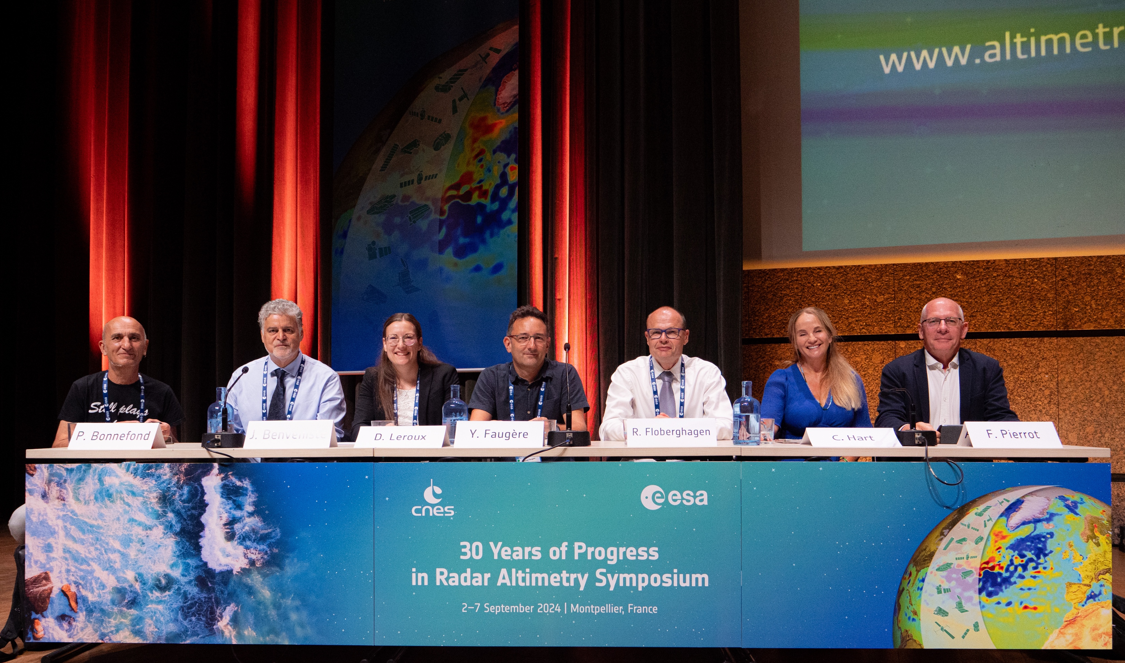
Welcome from Montpellier, ESA and CNES
8 Keynotes on Monday morning
481 submitted abstracts: 212 oral presentations, 270 posters reporting the progress all week.
13 Themes, an entire session block dedicated to outlook discussions and recommendations.
2 Round Tables on this Friday morning
1. Looking at the past, lesson learned and discussions on the 30 Year Record
2. Future scientific challenges, open science questions

Slide 5
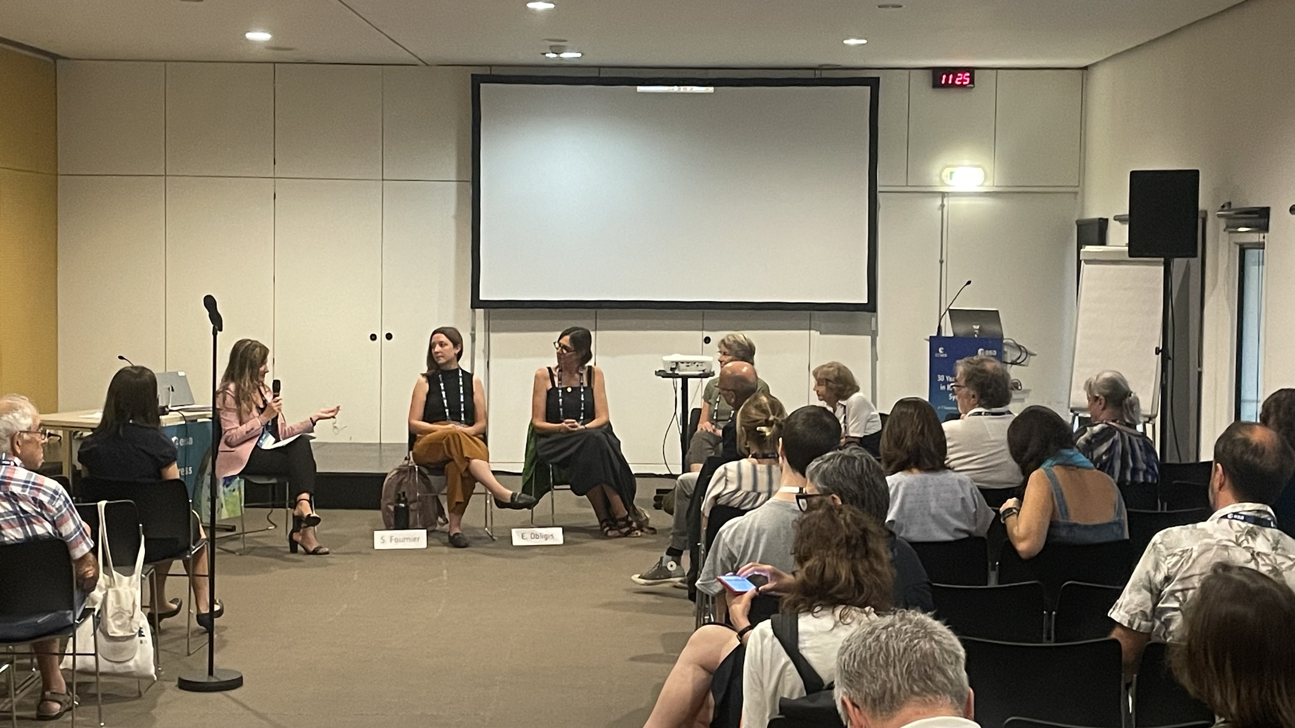
Women Trailblazers Session:
The present and the future of Remote Sensing Ocean and Hydrology science and engineering

Slide 6
Progress Summary and Recommendations for the Future
The major outcome of the Symposia is a "Progress Summary and Recommendations for the Future" document. In the past, these documents were milestones and prospective tools gathering Community Requirements for shaping the future of altimetry. They are instrumental to convey the Recommendations of the Altimetric Community. They are drafted by the co-chairs of the sessions.
The input come from: -
the Open Discussion on Thursday PM
the 2 Round Tables on this Friday morning
the Sessions Summaries
the general discussion
The document is drafted by the co-chairs of the sessions and the Organising Committee

Slide 7
The major outcome of the Symposium is a "Progress Summary and Recommendations for the Future" document!
Your further input is welcome!
If you want to pitch more in, send email…

Slide 8
Presentations will be published online in PDF – please advise if you don’t want yours published
Posters as well! Of course!! They are much more explicit than slides!!!
Send your oral presentation if you have made some corrections.
Send PDFs to the ESA Conference Bureau
Events.Organisation@esa.int
Please take your Posters down before leaving.

Slide 9
Code of Ethics and Code of Conduct
As the community grows larger and larger we should think of drafting a Code of Ethics and a Code of Conduct, as AGU, EGU, COSPAR, etc.
For the next OSTST, CAW, HYDROSPACE, 35YPRA, etc.

Slide 10
SPECIAL WARM THANKS TO …
Riccardo and Giulia (ESA Conference Bureau)
Giorgia, Ornella, and Marco (ESA Earth Observation Graphic Bureau)
And all the supportive others from CNES and ESA

Slide 11
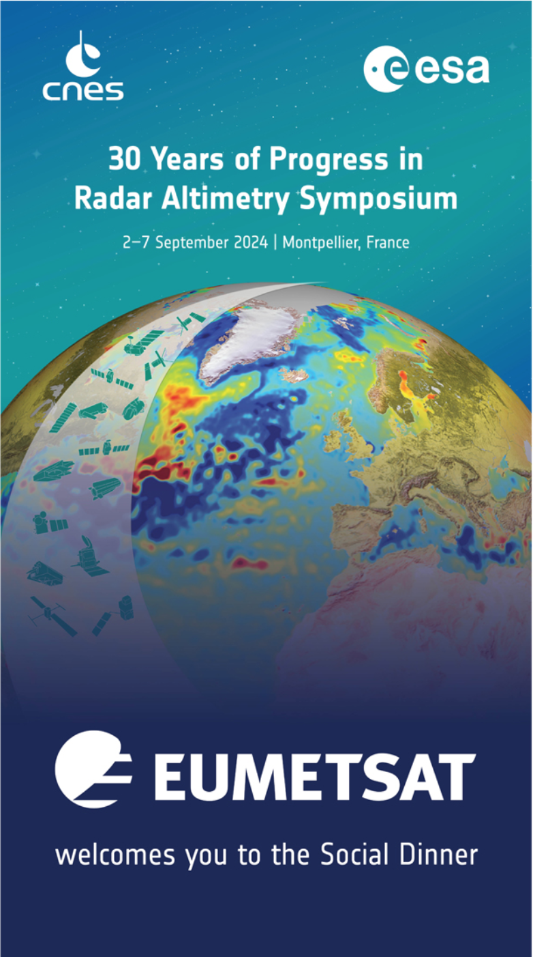
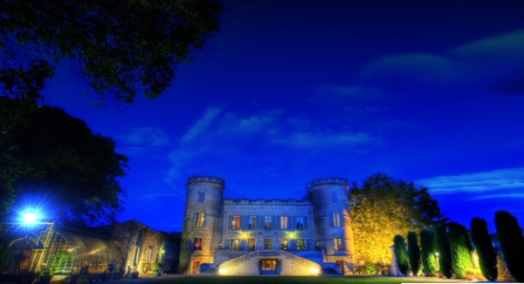
Symposium Dinner on Wednesday evening at Château de Pouget 😀 🥂
HEARTFEALT THANKS TO EUMETSAT for Sponsoring the Social Dinner!

Slide 12
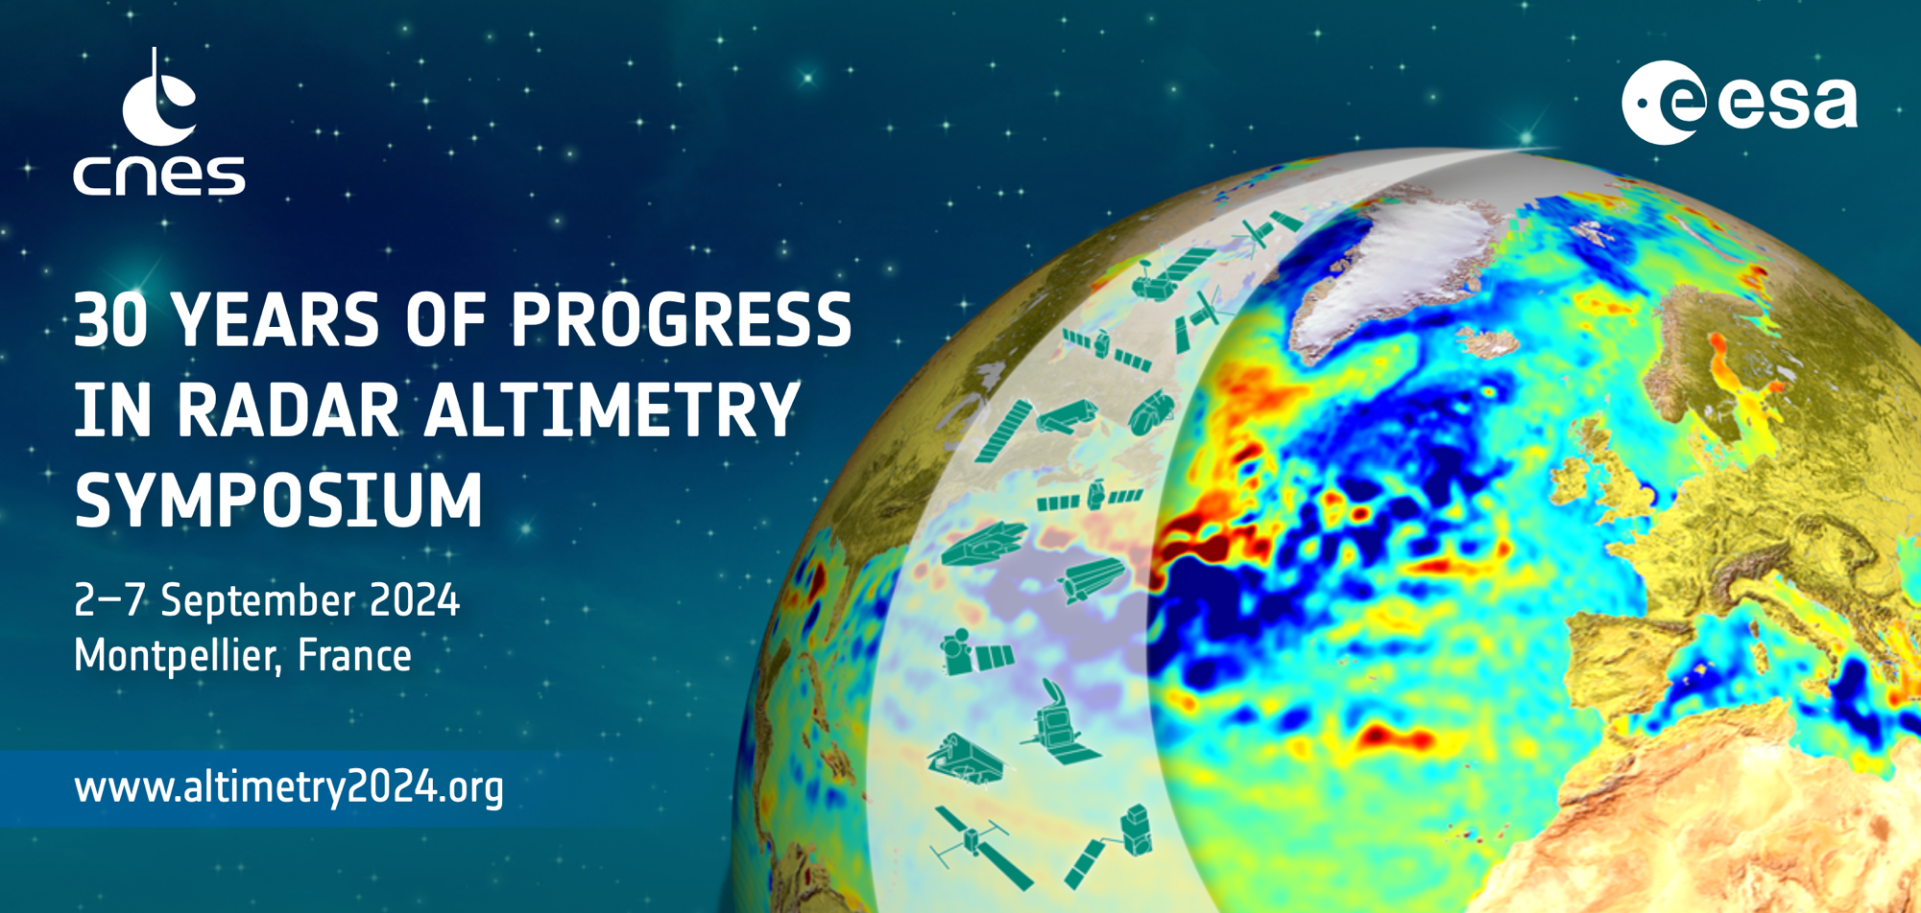
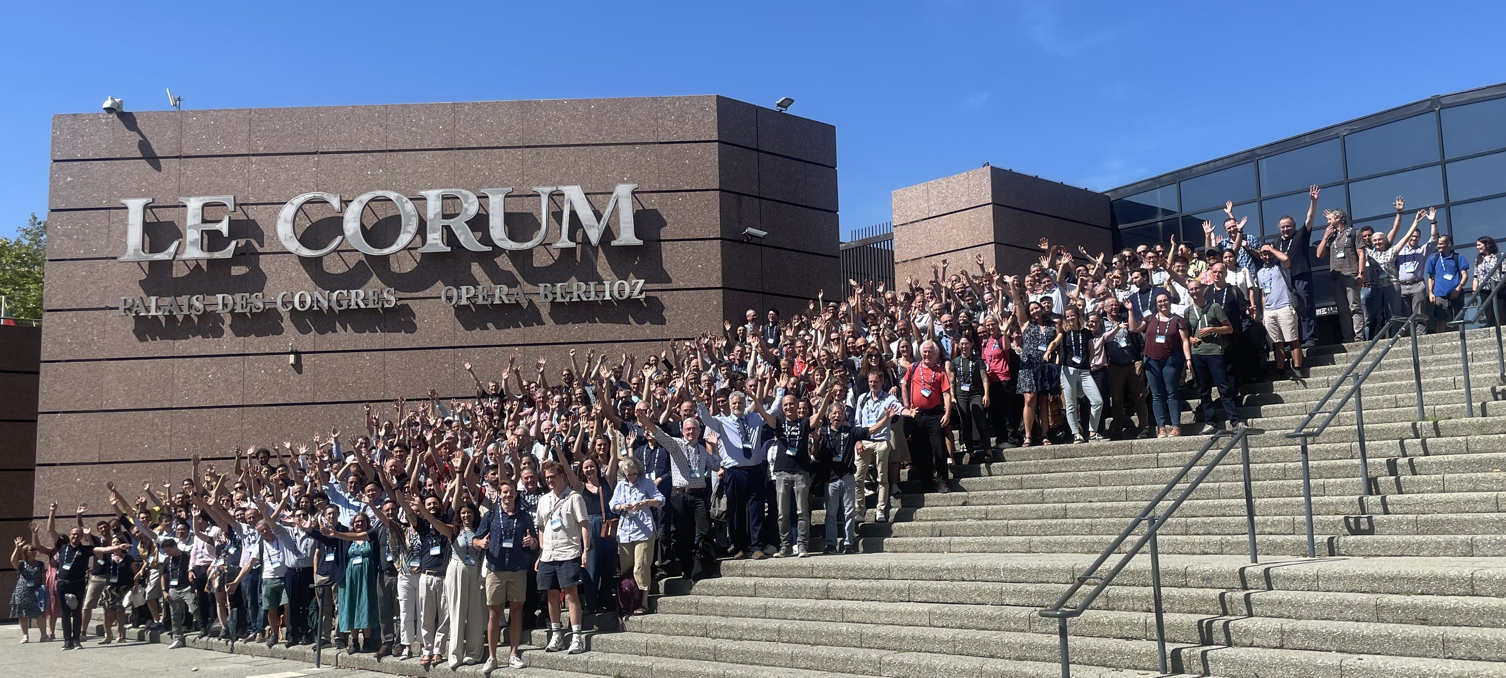
THANKS TO ALL OF YOU! The success is from your contributions!

Slide 13
THANKS TO ALL OF YOU! The success is from your contributions!

Slide 14
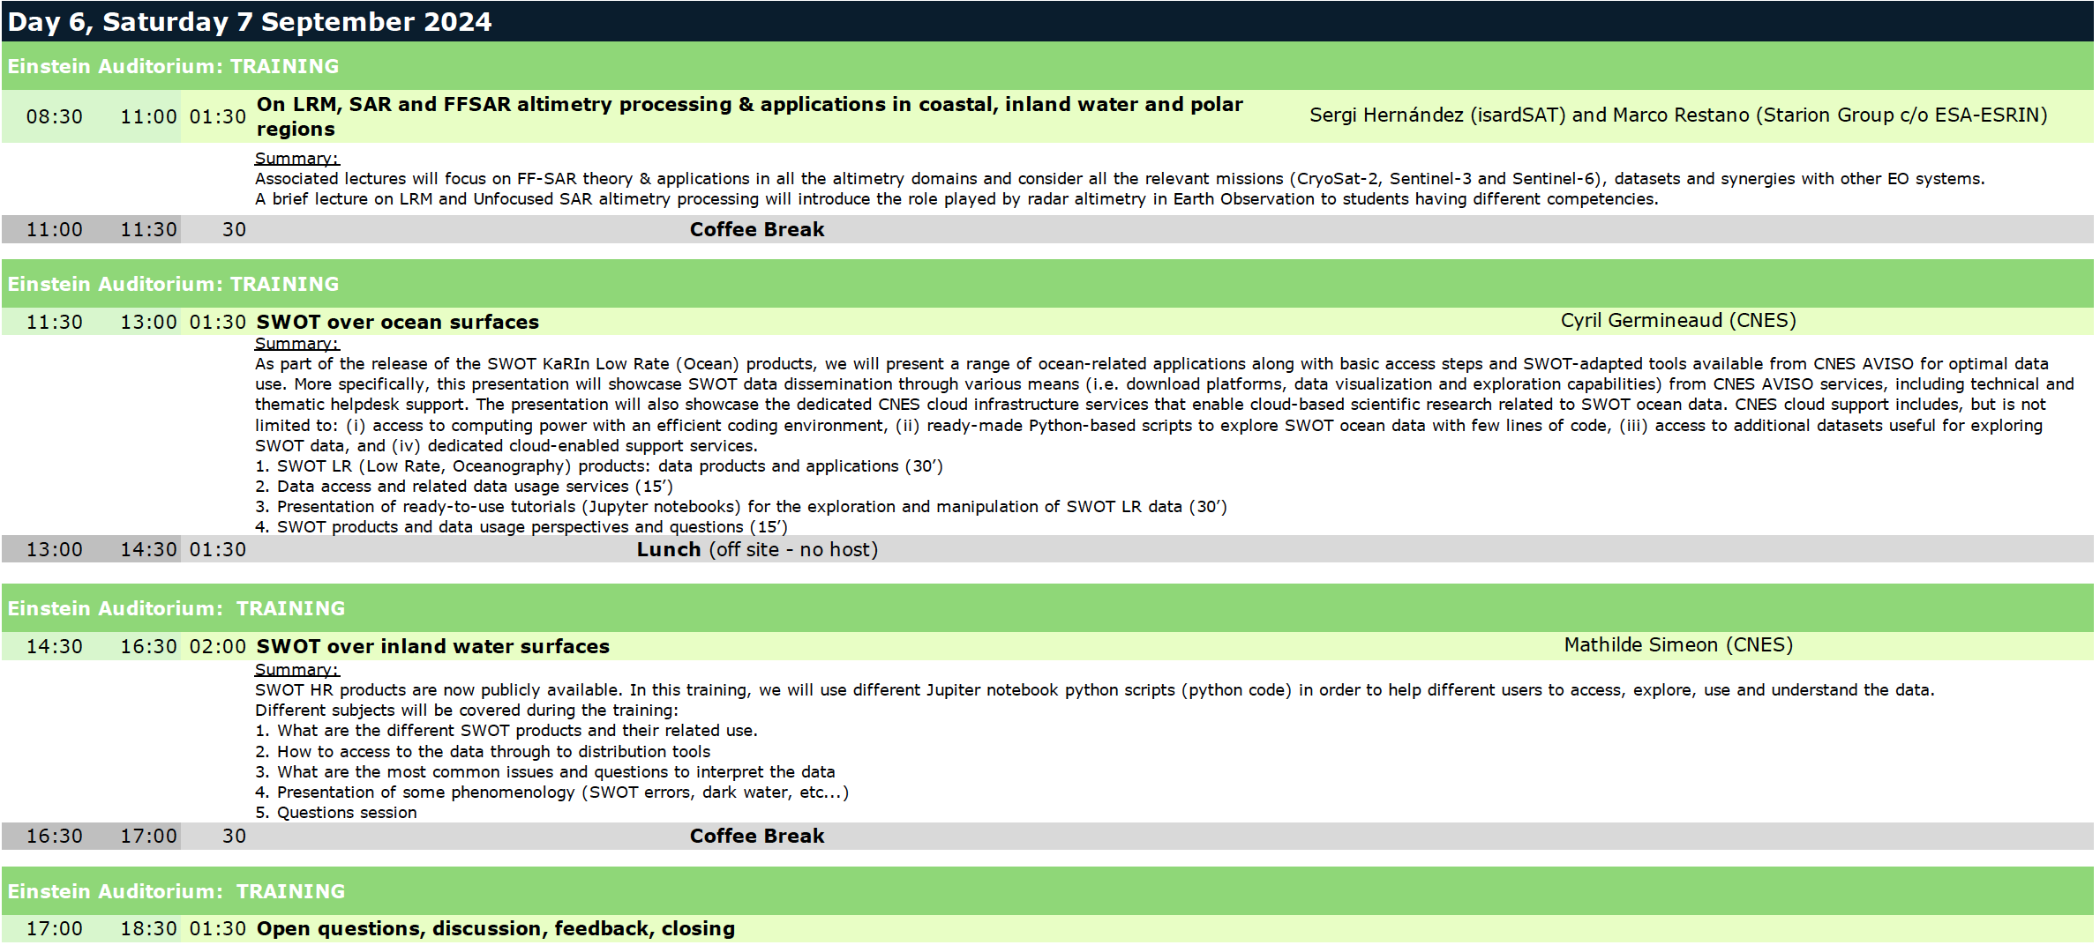
Saturday Training Courses in Einstein 8:30-18:30

Slide 17
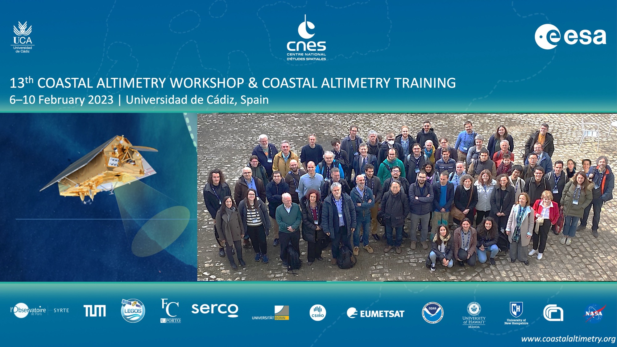
Coastalaltimetry.org

Slide 18
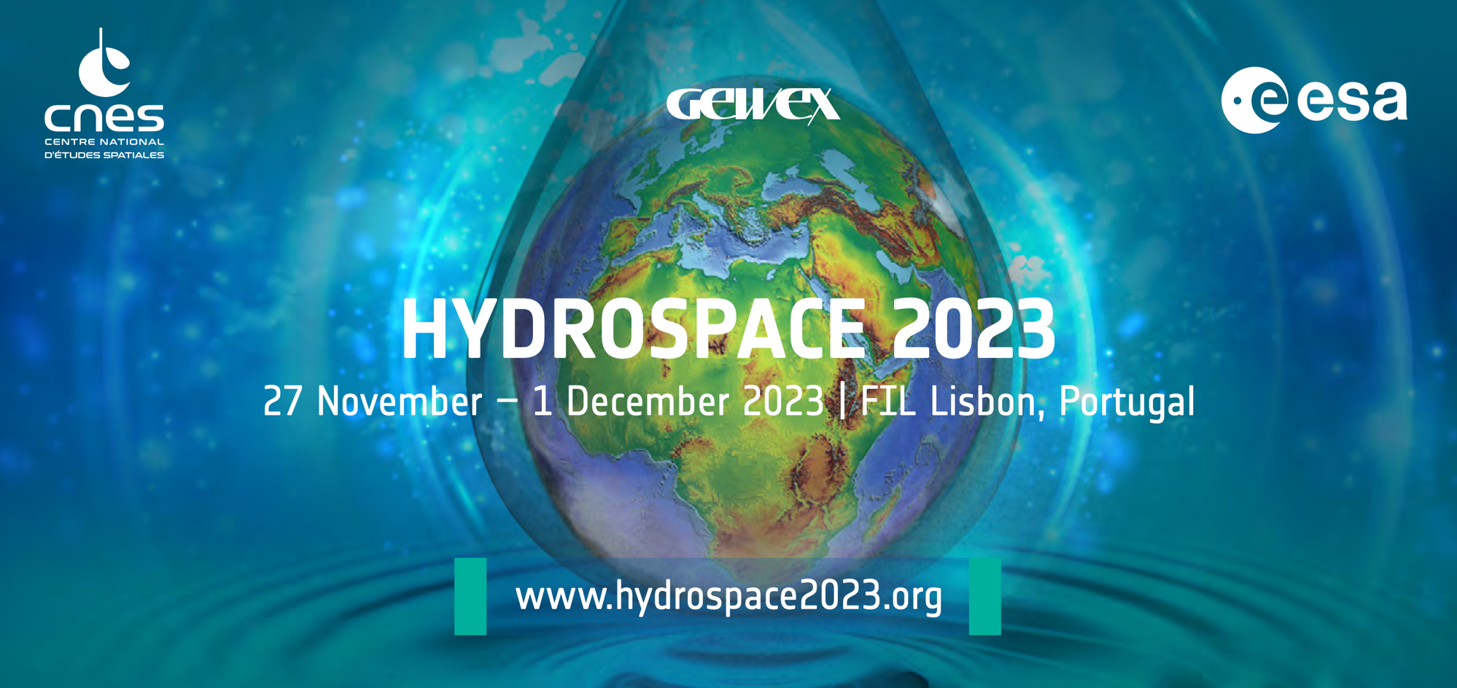

Slide 19
See you there!

Slide 20
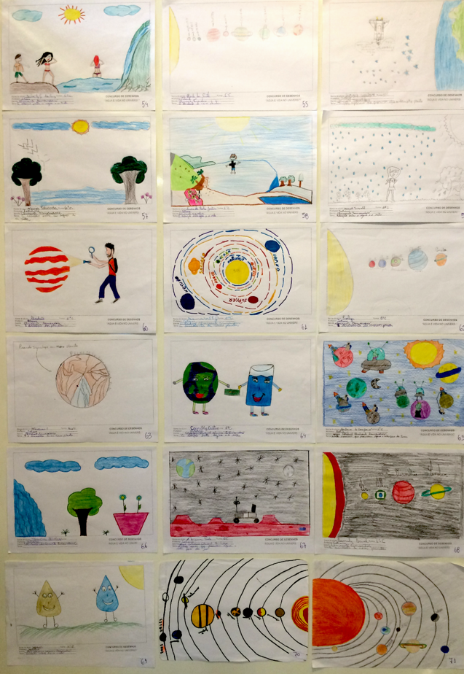
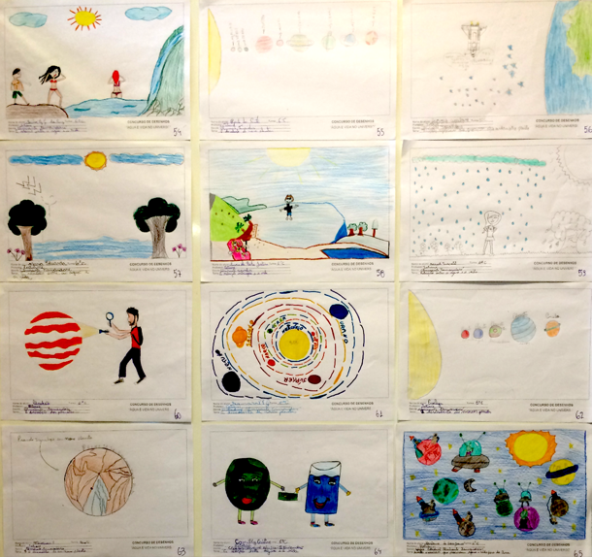
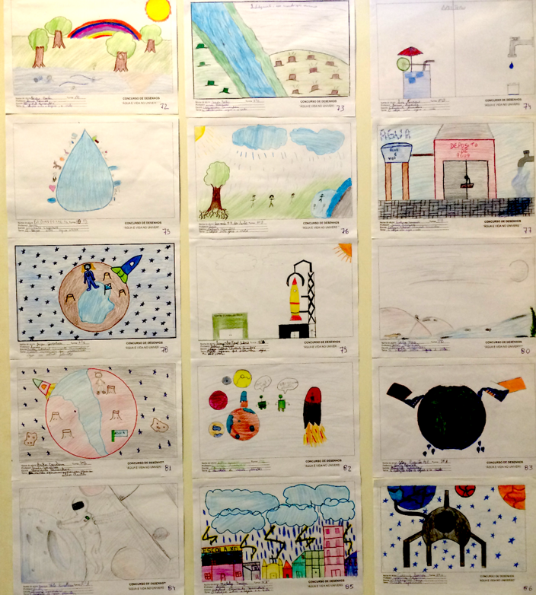
We need the younger generation to step-up to lead the Community into the future!
Kids drawing contest at the 2nd COSPAR Symposium “Water and Life in the Universe” in Foz do Iguaçu, Brazil, 9-13 November 2015

Slide 21
35
www.altimetry2030.org
Shall we meet for a “35 Years of Progress in Altimetry” Symposium?

Slide 22
See some of you tomorrow and wishing you a safe trip home!

